Slide 1
Mobile and Wireless Technology CT090-3-2-MWT Version VD01
WiMax and LTE

Slide 2
Topic & Structure of The Lesson
2G, 3G, 4G, 5G
WiMAX and LTE
Key Network Technologies
Cellular Network Architecture
Mobile WiMAX Versus Wi-Fi
Mobile WiMAX Versus Cellular Mobile Networks

Slide 3
Learning Outcomes
At the end of this topic, You should be able to
Be familiar with 2G, 3G, 4G and 5G technologies
Compare WiMAX and LTE
Know Key Network Technologies
Know the importance of Network Architecture
Compare Mobile WiMAX with Wi-Fi
Compare Mobile WiMAX with Cellular Mobile Networks

Slide 4
Key Terms You Must Be Able To Use
If you have mastered this topic, you should be able to use the following terms correctly in your assignments and exams:
WiMAX (Worldwide Interoperability for Microwave Access)
Wi-Fi (Wireless Fidelity)
LTE (Long Term Evolution)
Bluetooth
Zigbee
Mobile WiMAX
Cellular Network

Slide 5
Topic & Structure of The Lesson
2G, 3G, 4G, 5G
WiMAX and LTE
Key Network Technologies
Cellular Network Architecture
Mobile WiMAX Versus Wi-Fi
Mobile WiMAX Versus Cellular Mobile Networks

Slide 6
1G vs 2G vs 3G vs 4G vs 5G
Generation | Definition | Throughput/ Speed | Technology | Time period | Features
1G | Analog | 14.4 Kbps (peak) | AMPS, NMT,TACS | 1970 – 1980 | During 1G Wireless phones are used for voice only.
2G | Digital Narrow band circuit data | 9.6/14.4 Kbps | TDMA,CDMA | 1990 to 2000 | 2G capabilities are achieved by allowing multiple users on a single channel via multiplexing. During 2G Cellular phones are used for data also along with voice.
2.5G | Packet Data | 171.2 Kbps(peak) 20-40 Kbps | GPRS | 2001-2004 | In 2.5G the internet becomes popular and data becomes more relevant.2.5G Multimedia services and streaming starts to show growth. Phones start supporting web browsing though limited and very few phones have that.

Slide 7
1G vs 2G vs 3G vs 4G vs 5G
3G | Digital Broadband Packet Data | 3.1 Mbps (peak) 500-700 Kbps | CDMA 2000 (1xRTT, EVDO) UMTS, EDGE | 2004-2005 | 3G has Multimedia services support along with streaming are more popular. In 3G,Universal access and portability across different device types are made possible. (Telephones, PDA’s, etc.)
3.5G | Packet Data | 14.4 Mbps (peak) 1-3 Mbps | HSPA | 2006 – 2010 | 3.5G supports higher throughput and speeds to support higher data needs of the consumers.
4G | Digital Broadband Packet All IP Very high throughput | 100-300 Mbps (peak) 3-5 Mbps 100 Mbps (Wi-Fi) | Wi-Max LTE Wi-Fi |  | Speeds for 4G are further increased to keep up with data access demand used by various services. High definition streaming is now supported in 4G. New phones with HD capabilities surface. It gets pretty cool. In 4G,Portability is increased further. World-wide roaming is not a distant dream.

Slide 8
1G vs 2G vs 3G vs 4G vs 5G
5G | Not Yet | Probably gigabits | Not Yet | Soon (probably 2020) Update: Samsung conducts tests on 5G | Currently there is no 5G technology deployed. When this becomes available it will provide very high speeds to the consumers. It would also provide efficient use of available bandwidth as has been seen through development of each new technology.

Slide 9
Topic & Structure of The Lesson
2G, 3G, 4G, 5G
WiMAX and LTE
Key Network Technologies
Cellular Network Architecture
Mobile WiMAX Versus Wi-Fi
Mobile WiMAX Versus Cellular Mobile Networks

Slide 10
Wi-Max and LTE
Long Term Evolution (LTE) is a 4G wireless broadband technology developed by the Third Generation Partnership Project (3GPP), an industry trade group.
3GPP engineers named the technology "Long Term Evolution" because it represents the next step 4G in a progression from GSM (Global System for Mobile Communication), a 2G standard, to UMTS (Universal Mobile Telecommunications Service), the 3G technologies based upon GSM.

Slide 11
Wi-Max and LTE
LTE provides increased peak data rates, with the potential for 100 Mbps downstream and 30 Mbps upstream, reduced latency, scalable bandwidth capacity, and backwards compatibility with existing GSM and UMTS technology.
WiMAX is Worldwide Interoperability for Microwave Access. Based on Wireless MAN technology.

Slide 12
Wi-Max and LTE
WiMAX is one of the hottest broadband wireless technologies around today. Wi-MAX systems are expected to deliver broadband access services to residential and enterprise customers in an economical way.
WiMAX would operate similar to Wi-Fi, but at higher speeds over greater distances and for a greater number of users. WiMAX has the ability to provide service even in areas that are difficult for wired infrastructure to reach and the ability to overcome the physical limitations of traditional wired infrastructure.

Slide 13
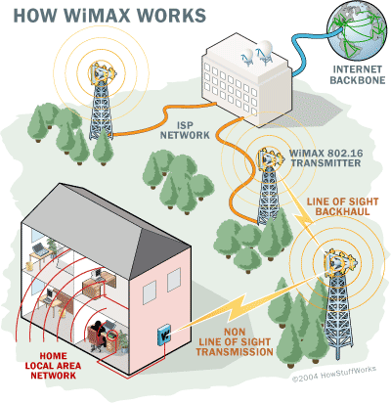
Wi-Max and LTE

Slide 14
Topic & Structure of The Lesson
2G, 3G, 4G, 5G
WiMAX and LTE
Key Network Technologies
Cellular Network Architecture
Mobile WiMAX Versus Wi-Fi
Mobile WiMAX Versus Cellular Mobile Networks

Slide 15
Key Mobile & Wireless Technologies
Wi-Fi, the most popular wireless standard for networking computer systems, has the following basic characteristics:
Multi-user configuration
IEEE 802.11b data rate is 11Mbps
IEEE 802.11g data rate is 54Mbps
Frequency band is the 2.4Ghz band
Range of 100-150 feet
Equipment and Wi-Fi systems/access points are usually privately owned

Slide 16
Key Mobile & Wireless Technologies
WiMAX (IEEE 802.16) wireless technologies has a primary focus of enabling a wireless alternative for cable, DSL, and T1 communication channels for consumer last-mile access to the Internet, including high-speed data, Voice over IP (VoIP), Video on Demand (VoD), and backhaul for IEEE 802.11 LANs.
WiMAX addresses the "first-mile/last-mile" connection for longer distances and faster rates.
– Multi-user configuration
– Range of 5 to 30 miles (5 more likely)
– Data rates of (45-75 Mbps)

Slide 17
Key Mobile & Wireless Technologies
Cellphone data standards, GPRS, is part of GSM effort to create a common European mobile telephone standard for a pan-European mobile cellular radio system (and now worldwide).
The resulting mobile telephone standard allows cellphone users to “roam” across many cellphone systems and between most countries world-wide.

Slide 18
Key Mobile & Wireless Technologies
New generations of cellphone technologies, termed 2.5G, 3G, and 4G are deployed in certain countries or are still under development.
Multi-user configuration
GPRS commonly used for data, with 30-80 kbps typical.

Slide 19
Key Mobile & Wireless Technologies
Bluetooth is used in cellphones, Personal Digital Assistants (PDAs), and other mobile wireless devices, primarily for communicating with computers, Intelligent Electronic Devices (IEDs), headsets, hands-free systems, and other gadgets.
The characteristics of Bluetooth as follows:
Point-to-point links
Very short range of only 33 feet (approx 10m)
Frequency band is the 2.4Ghz band.
Relatively low data rate of 1.5Mbps
Equipment and Bluetooth systems are privately owned

Slide 20
Key Mobile & Wireless Technologies
Zigbee, based on IEEE 802.15.4, defines low-rate, very low duty cycle, wireless personal area networks often termed “meshed networks” as opposed to point-to-point.
Zigbee builds upon this 802.15.4 standard to define application profiles that can be shared among different manufacturers to provide system-to-system interoperability.
This effort is still a work in progress, although of great interest to industries (such as the power industry) that have extensive sensor networks.

Slide 21
Key Mobile & Wireless Technologies
The characteristics of Zigbee as follows:
Multi-user configuration
Range between devices is 30-300 feet.
High availability due to meshed network configuration
Low data rate of <250 kbps
Equipment and Zigbee systems are usually privately owned

Slide 22
Topic & Structure of The Lesson
2G, 3G, 4G, 5G
WiMAX and LTE
Key Network Technologies
Cellular Network Architecture
Mobile WiMAX Versus Wi-Fi
Mobile WiMAX Versus Cellular Mobile Networks

Slide 23
Cellular Network
Traditional base station infrastructure systems
Cellular network consists of three subsystems. They are:
Base Station Subsystem – MS,BTS & BSC
Network Switching Subsystem – VLR,HLR,EIR,AUC & MSC
Operation Support Subsystem - OMC

Slide 24
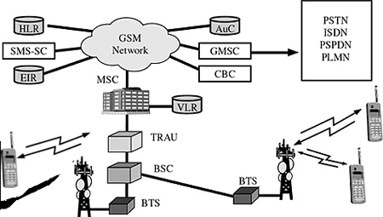
Cellular Network

Slide 25
Cellular Network
Base Station Subsystem
Mobile Station - Hardware & SIM (Subscriber Identity Module)
BTS – Base Transceiver Station
The BTS is the Mobile Station's access point to the network. It is responsible for carrying out radio communications between the network and the MS.
BSC – Base Station Controller - The BSC controls multiple BTSs.

Slide 26
Network Switching Subsystem
It consists of five functional units. They are:
MSC - The Mobile Switching center is the heart of the GSM network. It handles call routing, call setup, and basic switching functions.
HLR – Home Location Register- The HLR is a large database that permanently stores data about subscribers. The HLR maintains subscriber-specific information such as the MSISDN, IMSI, current location of the MS, roaming restrictions, and subscriber supplemental features.
VLR - Visitor Location Register (VLR) The VLR contains a copy of most of the data stored at the HLR. It is, however, temporary data which exists for only as long as the subscriber is “active” in the particular area covered by the VLR.
AuC –Authentication Center - The authentication center (AuC) is a function to authenticate each SIM card that attempts to connect to the GSM core network (typically when the phone is powered on).
EIR – Equipment Identity Register - The EIR is a database that keeps tracks of handsets on the network using the IMEI.

Slide 27

Cellular Network
Operation Support Subsystem - OMC – Operation and Maintenance center monitors and controls the system. It supports Maintenance activities of different operations.

Slide 28
Wireless Network
Infrastructure as well as ad-hoc networks possible
Very flexible within the reception area
Low bandwidth compared to wired networks (1-10 Mbit/s)

Slide 29
Cellular & Wireless Network Architecture- Wireless Network Ad-hoc Network
Direct communication within a limited range
Station (STA): terminal with access mechanisms to the wireless medium
Basic Service Set (BSS): group of stations using the same radio frequency
STA₂
STA₁
Ad hoc Networks
BSS₂
STA₅
STA₄

Slide 30
Mobile & Wireless Network Architecture-
Wireless LAN- Infrastructure
Station (STA)
terminal with access mechanisms to the wireless medium and radio contact to the access point
Basic Service Set (BSS)
group of stations using the same radio frequency
Access Point
station integrated into the wireless LAN and the distribution system
Portal
bridge to other (wired) networks
Distribution System
interconnection network to form one logical network (EES: Extended Service Set) based on several BSS
Wireless LANs
STA₁
BSS₁
Access
Point
Portal
Distribution System
Access
Point
BSS₂
ESS
STA₂
STA₃

Slide 31
Topic & Structure of The Lesson
2G, 3G, 4G, 5G
WiMAX and LTE
Key Network Technologies
Cellular Network Architecture
Mobile WiMAX Versus Wi-Fi
Mobile WiMAX Versus Cellular Mobile Networks

Slide 32
Mobile WiMAX Versus Wi-Fi
WiMAX was designed to replace the last-mile wired-broadband access networks while Wi-Fi was created for providing services into LAN networks.
WiMAX technology to support peak Down Link data rates up to 63 Mbps per sector and peak Up Link data rates up to 28 Mbps per sector in a 10 MHz channel. Whereas, Wi-Fi data rates summary as follows:
Protocol | Frequency | Signal | Maximum data rate
Legacy 802.11 | 2.4 GHz | FHSS or DSSS | 2 Mbps
802.11a | 5 GHz | OFDM | 54 Mbps
802.11b | 2.4 GHz | HR-DSSS | 11 Mbps
802.11g | 2.4 GHz | OFDM | 54 Mbps
802.11n | 2.4 or 5 GHz | OFDM | 600 Mbps (theoretical)
802.11ac | 5 GHz | 256-QAM | 1.3 Gbps

Slide 33
Mobile WiMAX Versus Wi-Fi
At the PHY layer, WiMAX channel sizes ranges from 1.75 MHz to 20 MHz while Wi-Fi based products require at least 20 MHz for each channel.
Wi-Fi uses the CSMA/CA (Carrier Sense Multiple Access with Collision Avoidance) which is not an efficient protocol. The MAC layer in WiMAX has been designed to scale from one to up 100s users within one RF channel.
In WiMAX, the base station assigns a QoS class to each connection. In 802.11, QoS was not considered in the early stage of its implementation.

Slide 34
Mobile WiMAX Versus Wi-Fi
WiMAX supports many transport technologies, such as ATM, IPv4, and IPv6 which are not supported by Wi-Fi.
WiMAX has the ability to support longer range transmission. While 802.11 was designed for low power consumption which limit the coverage to hundreds of meters.

Slide 35
Topic & Structure of The Lesson
2G, 3G, 4G, 5G
WiMAX and LTE
Key Network Technologies
Cellular Network Architecture
Mobile WiMAX Versus Wi-Fi
Mobile WiMAX Versus Cellular Mobile Networks

Slide 36
WiMAX Versus LTE
Comparison in terms of | WiMax | LTE
Standard | Is a technology standardized by IEEE | Is a technology standardized by 3GPP
Spectrum | Higher licensed and unlicensed bands | Lower licensed bands
Mode of Operation | TDD is the main mode | FDD is the main mode
Coverage | Targeted dedicated coverage | Targeted wide coverage

Slide 37
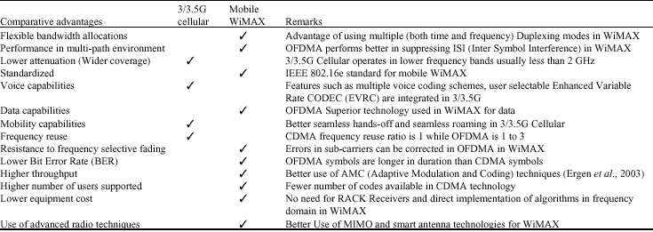
Mobile WiMAX Versus Cellular

Slide 38
Quick Review Question
What is WiMax? How it works?
Briefly explain cellular network.
Compare WiMax with WiFi.

Slide 39
Summary of Main Teaching Points
In this chapter, we discussed the following:
WiMAX
LTE
Wireless Network Technologies
Cellular & Wireless Network Architecture
Mobile WiMAX Versus Wi-Fi
Mobile WiMAX Versus Cellular

Slide 40
Question and Answer Session
Q & A

Slide 41
What we will cover next
IoT and Wireless Sensor Networks
Internet of Things – Applications
Smart Cities
Manufacturing
Home Automation
VANETS
Body Area Networks
IEEE 802.5.14
Zigbee

